Slide 1
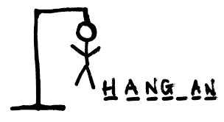
HANGMAN
Final project

Slide 2
About game
Game consist of 5 rounds
In each round player is given a new hint for a word
Player has to guess the word letter by letter with minimum errors
Maximum errors allowed per word is 7
One line of hanged man is drawn for each error
To win the game user has to guess at least 3 words out of 5 correctly

Slide 3
How to play
Initially player has to register and login to the game
Then player has to guess the first word letter by letter
If player is able to guess the word player is promoted to the next round with a point
If player fails to guess the word, player is promorted to the second round with no points
At the end of 5 rounds player should take at least 3 points to win

Slide 4
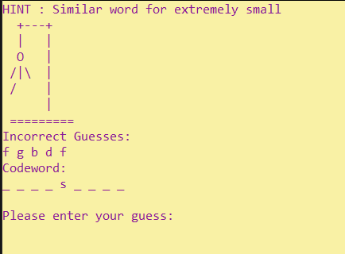
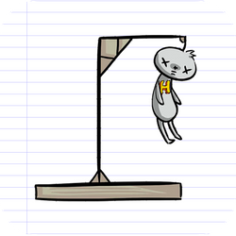
Demonstration of the game

Slide 5
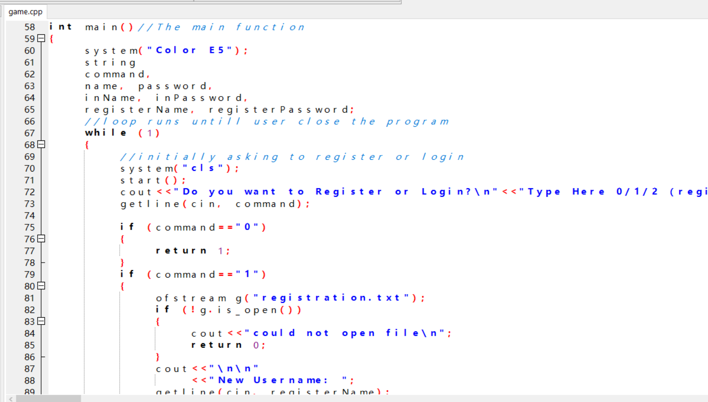
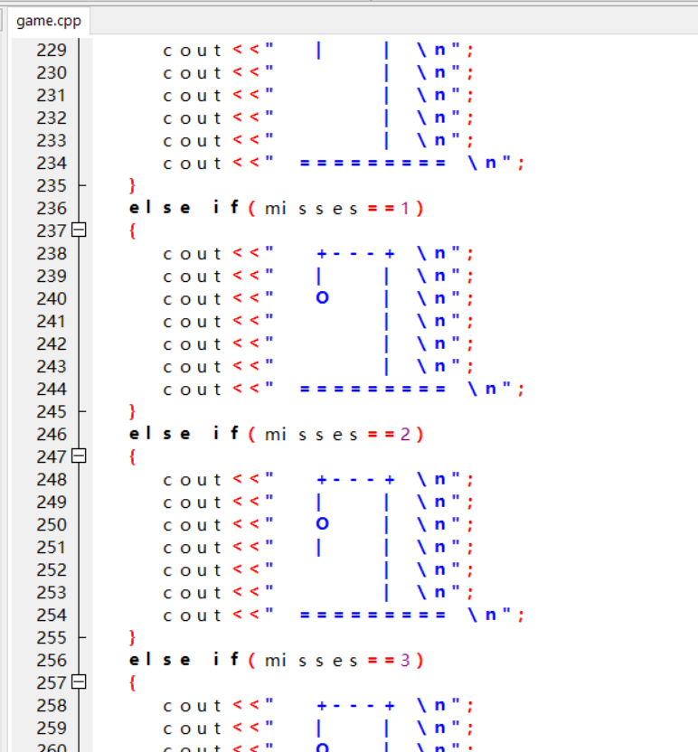
About the code
Whole program runs within a loop. Loop runs until player terminate the program.
5 user defined functions are used
User registration information stored in a file
5 words are selected randomly from a array of 20 words

Slide 6
Challenges
Selecting a game
01
Deciding the game structure
02
Designing the interface
03
Taking only one letter as the guess
04
Deciding the method to terminate the game
05

Slide 7
To Improve
More attractive interface
A separate database of words and hints
Allowing multiple players to play simultaneously
Restrict players from guessing the same letter again

Slide 8
Group members
IM/2019/085-Dinushi Ariyasena
IM/2019/027-Manod De Silva
IM/2019/106-Tashana Kodithuwakku
IM/2019/076-Visal Dias

Slide 9
Thankyou

